Slide 1
EVENTS IN JAVASCRIPT
Sai Vardhan T

Slide 2
EVENTS IN JS
The change in the state of an object is known as an Event
In HTML, various events represent that some activity is performed by the user or by the browser
When JavaScript code is included in HTML, JS reacts over these events and allows the execution
The process of reacting to the events is called Event Handling
Thus, JavaScript handles the HTML events via Event Handlers
For example, when a user clicks over the browser add js code which will execute the task to be performed on the event

Slide 3
TYPES OF EVENTS
MOUSE EVENTS
KEYBOARD EVENTS
FORM EVENTS
WINDOW / DOCUMENT WINDOW

Slide 4
MOUSE & WINDOW EVENTS
MOUSE EVENTS
CLICK
MOUSE OVER
MOUSE OUT
MOUSE UP
MOUSE MOVE
WINDOW / DOCUMENT WINDOW
ON LOAD
ON RESIZE

Slide 5
KEY BOARD EVENTS & FORM EVENTS
KEY BOARD EVENTS
KEY DOWN
KEY UP
FORM EVENTS
ON FOCUS
ON SUBMIT
ON BLUR
ON CHANGE

Slide 6
SERVER ACTIONS IN JS
Sai Vardhan T

Slide 7
SERVER ACTIONS
The actions used to perform certain actions using APIs are known as Server actions.
The actions will be made on the server with an API to access the data.
AJAX (Asynchronous JavaScript and XML) is used to interact and request data from the server.
Fetch Method:
Helps to communicate with the server

Slide 8
SERVER ACTIONS
AJAX CALLS:
SERVER PUT – Update
Status Code = 200
SERVER GET – Retrieve
Status code = 200
SERVER POST – Create
Status code = 201
SERVER DELETE – Delete
Status code = 204

Slide 9
CALL BACKS
“I will call back later”
A call back is a function passed as an argument to another function
This technique allows a function to call another function
A call back function can run after another function has finished
Example:
setTimeout(()=>{
console.log(“Hello World”);
},1000);

Slide 10
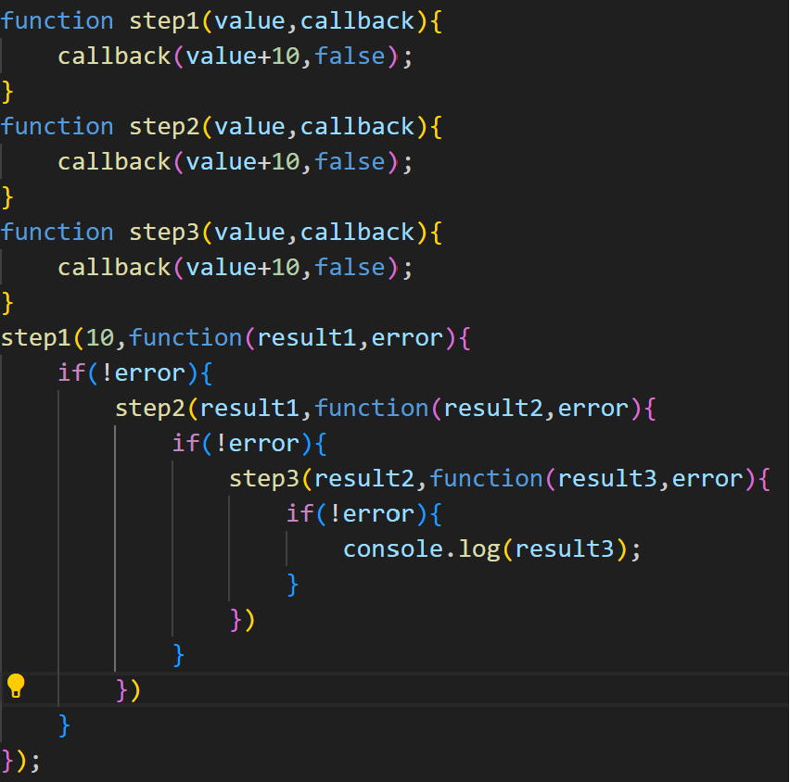
CALL BACK EXAMPLE

Slide 11
CALL BACK EXAMPLE
By the above example, if we take more than 10 internal functions, then it would be the result in more time complexity
This we used to call as call back hell
There are some solutions for all these Call back hells

Slide 12
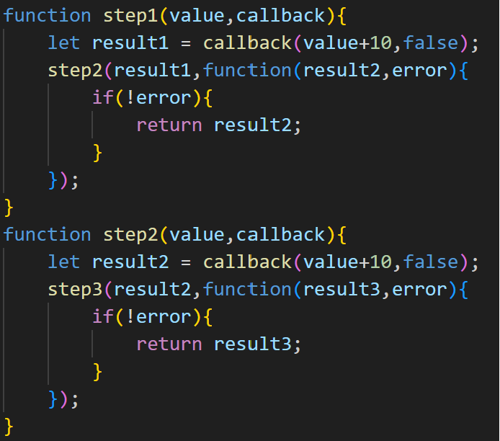
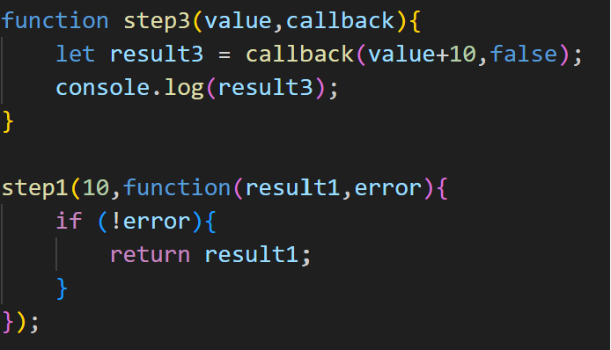
SOLUTION 1 (Spliting functions )

Slide 13
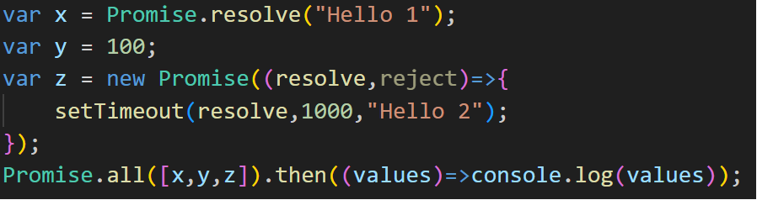
Solution 2 (Using Promise)
“I PROMISE A RESULT”
“Producing code” is code that can take some time
“Consuming code” is code that must wait for the result
Example:

Slide 14
Solution 2 (Using Promise)
Promise state and values
Pending - (Undefined)
Fillfilled - (resolved value)
Rejected - (reason for rejection)
Promise methods
Promise.all() – All outputs
Promise.race() – Which solved first will be displayed
Promise.any() – Any resolved
Promise.allSettled() – All either resolve or reject

Slide 15
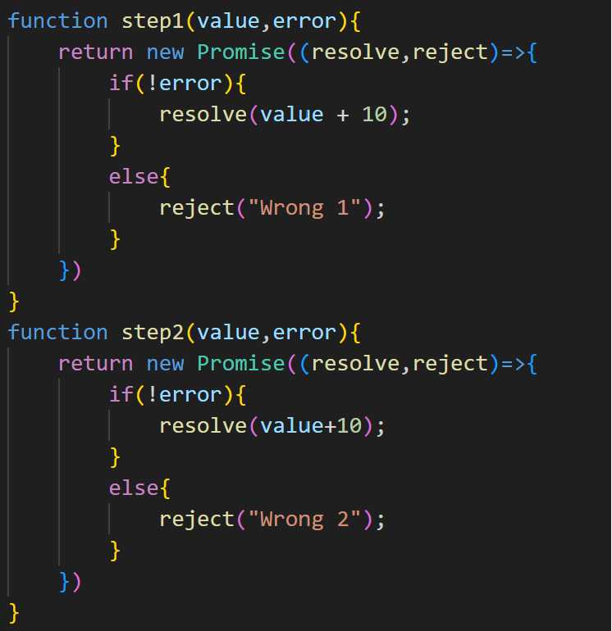
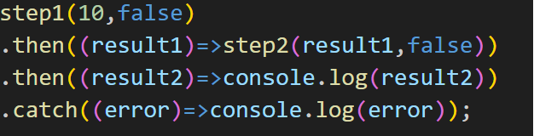
SOLUTION 2 (Using Promise)

Slide 16
Solution 3 (Using Async await)
Even though the data can be accessed by using promises, there are some disadvantages of using promises like chaining of promises.
“Async and Await make promises easier to write”
Async makes a function return a promise
Await makes a function wait for a promise
Note: Syntax changes only will be changes when compared to promise

Slide 17
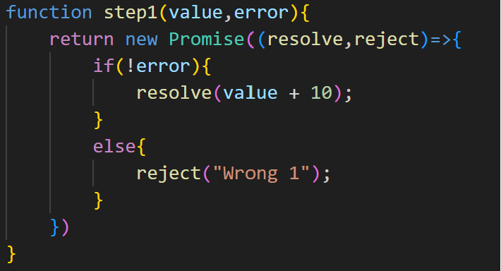
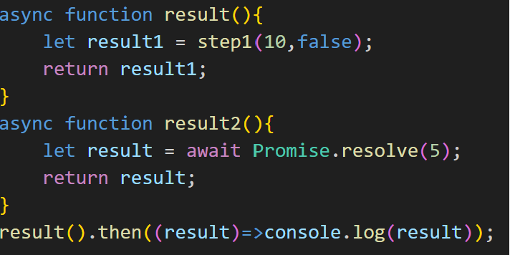
Solution 3 (Using Async await)
Example:

